Slide 1
Toxic Comment Detection
By
Y.Jyothsna Priya
D.Prathima
Shaik Asma
Shaik Asmath

Slide 2
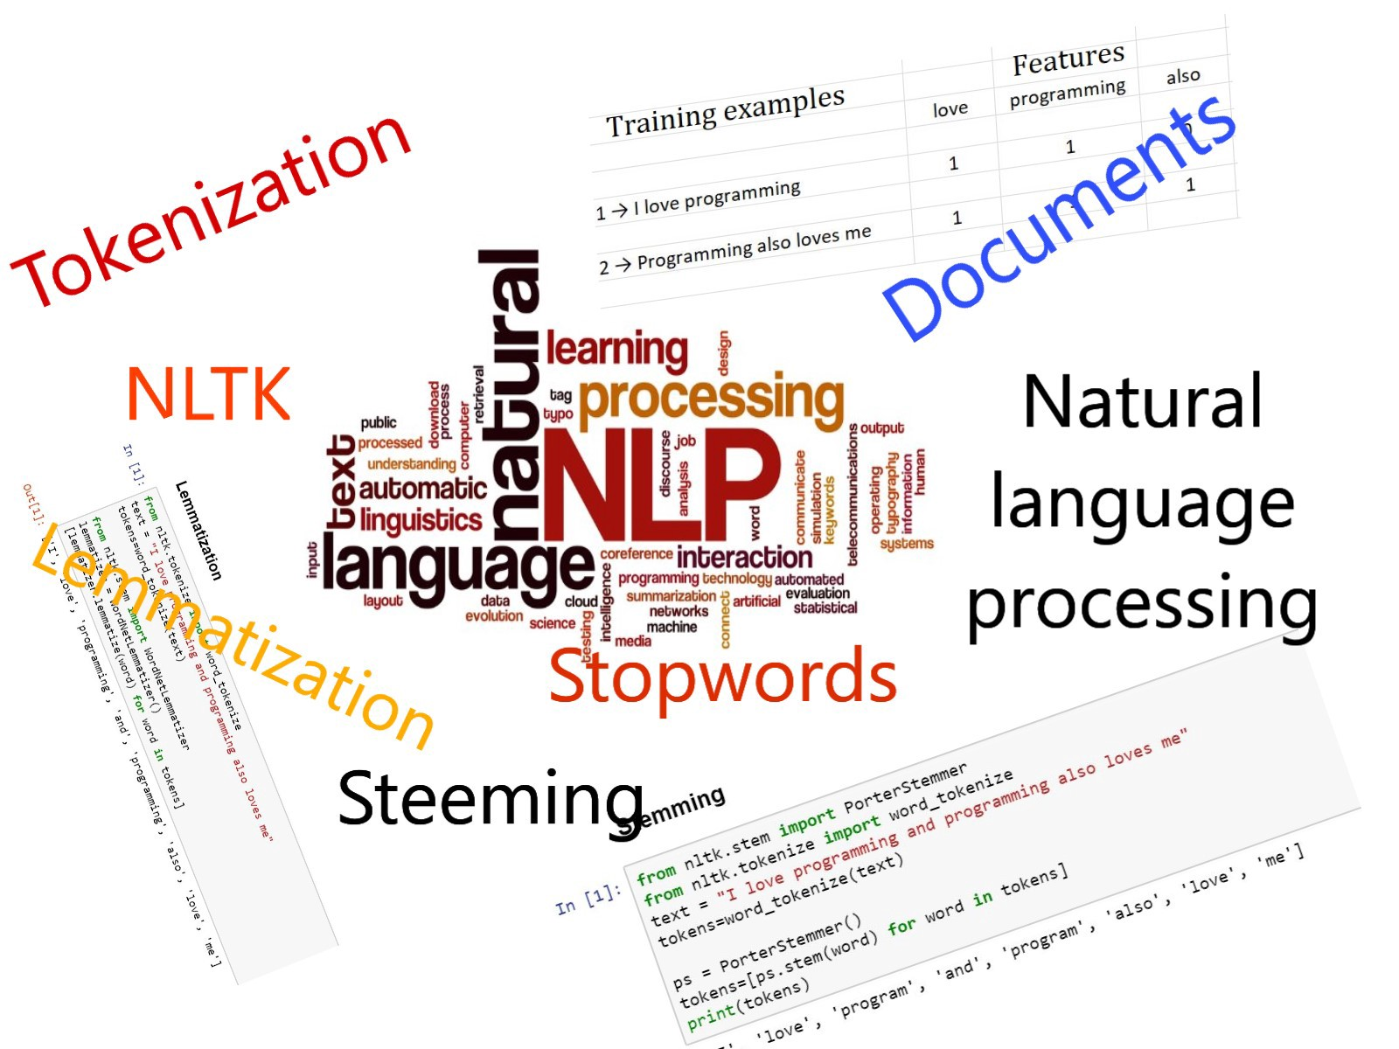
Introduction to NLP(Natural Language Processing) Algorithm
Natural Language Processing is a field that covers computer understanding and manipulation of human language, and it’s ripe with possibilities for news gathering

Slide 3
Problem Statement:
Given a group of sentences or paragraphs, used as a comment by a user in an online platform, classify it to belong to one or more of the following categories — toxic, severe-toxic, obscene, threat, insult or identity-hate with either approximate probabilities or discrete values (0/1).

Slide 4
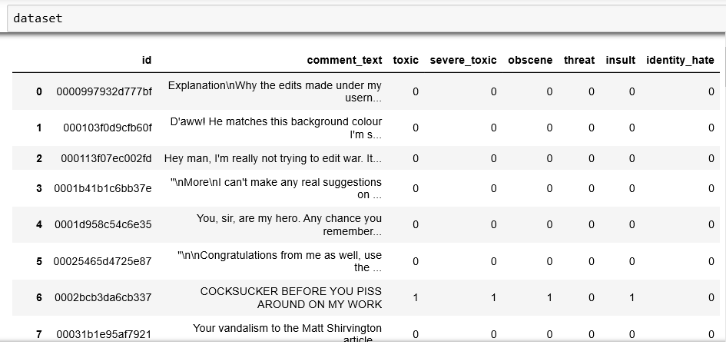
Dataset:

Slide 5
Steps in the Classification:
Importing the Libraries and the Dataset
Data Preprocessing
Divide the dataset into dependent and indepedent variables
Split data into train and test
Creating the model
Compile the model
Training the model
Predict te model

Slide 6
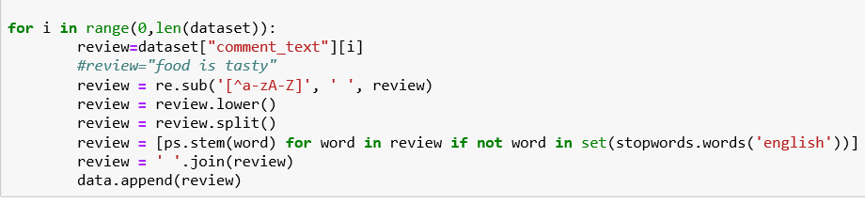
Data Preprocessing:
DATA PREPROCESSING IS A DATA MINING TECHNIQUE THAT INVOLVES TRANSFORMING RAW DATA INTO AN UNDERSTANDABLE FORMAT.REAL WORLD DATA IS OFTEN IN COMPLETE ,INCONSISTANCE ,LACKING OF BEHAVIOUR.

Slide 7
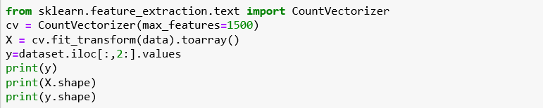
Divide the dataset into dependent and independent variables
X is a Independent variable
y is a dependent variable

Slide 8
Split data into train and test
We are training the data at 70% and test as 30%

Slide 9
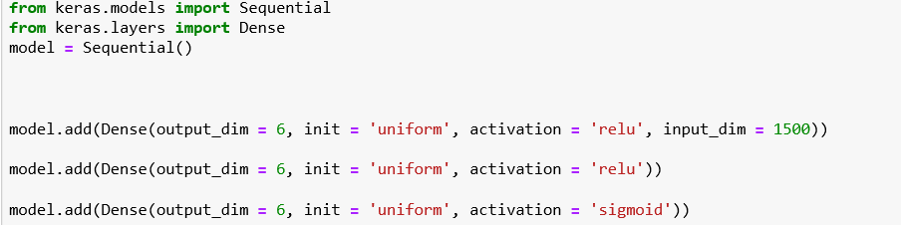
Creating a model:
Three Layers to create a model
Input Layer
Hidden Layer
Output Layer

Slide 10
Model Compilation
ONCE THE MODEL IS DEFINED IT IS NEED TO BE COMPILED THIS CRAETES THE EFFICIENT STRUCTURES USED BY THE UNDERLYING BACKEND IN ORDER TO EFFICIENT EXECUTE THE MODEL DURING TRAINING.

Slide 11
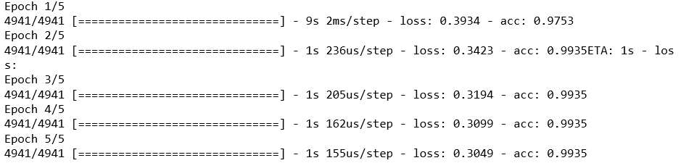
Training the Model

Slide 12
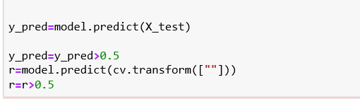
Predict the model:
WE CAN USE MODEL TO MAKE PREDICTION ON TEST DATA OR NEW DATA
model. Predict():- IS METHOD USED GENERATE NETWORK OUTPUT FOR INPUT DATA

Slide 13
Applications
Moderators of online discussion forums often struggle with controlling extremist comments on their platforms. To help provide an efficient and accurate tool to detect online toxicity

Slide 14
Conclusion
Using the developed model we can predict and classify the comments into 6 categories namely, Toxic, Severe-Toxic, Obscene, Insult, Threat, Identity-hate.
Our model is developed using Natural Language Processing where it automatically classifies the data using training and test splitting and optimizer techniques which is adam
Since, many users are limiting their social communications because the threat on various online platforms, we can help them by taking certain action on the netizens who are making social media an abusive platform so that, people can use the social media without any misery.

